Slide 1
Hotel Reservation Process

Slide 2
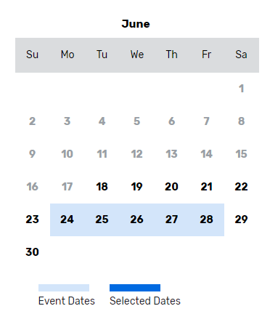
Reservation Process
Select check-in and check-out dates
Enter the number of rooms you need
Enter the average number of guests per room
Click “Search”
Click “Select” next to your assigned hotel

Slide 3
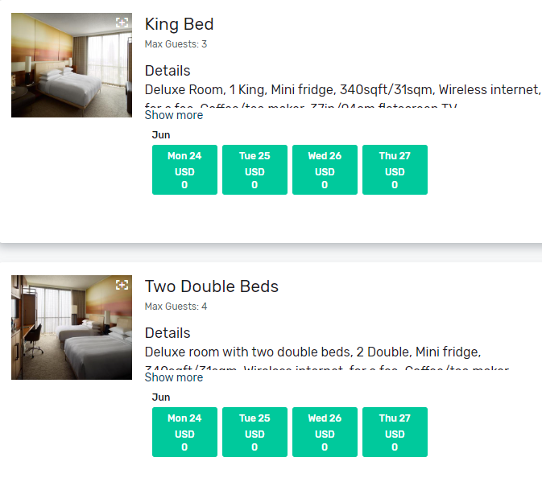
Registration Process for Advisors
Next, enter the # of rooms you need for each room type and click “Select” Passkey will show a warning message if you enter in too many or too few rooms
Booking Contact Information – as the lead of the group reservation, this is where you will put your information. Be sure to use your school’s address verses your personal address and include your school’s name.
The information provided on this page will be used to populate for all rooms in the reservation.

Slide 4
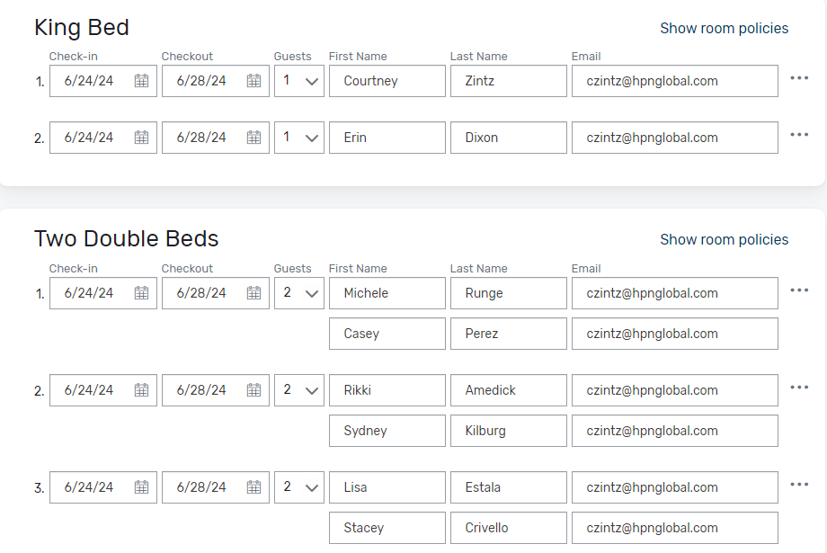
Reservation Process for Advisors
Now we are at the section where you will complete your rooming list.
It is required that you provide all names on all reservations. Hint: use the Tab key to go to the next name.
During this step, please leave your email address next to each student’s name. This ensures that all reservation information is only sent to you.
Clicking on the *** ellipsis icon next to a guest entry will give you the option to:
View and edit the guest details such as length of stay, personal information, payment, and billing details
Remove the room from the reservation.

Slide 5
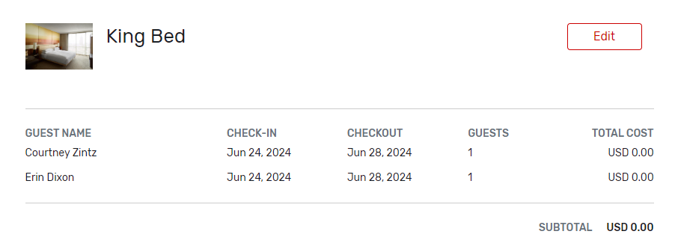
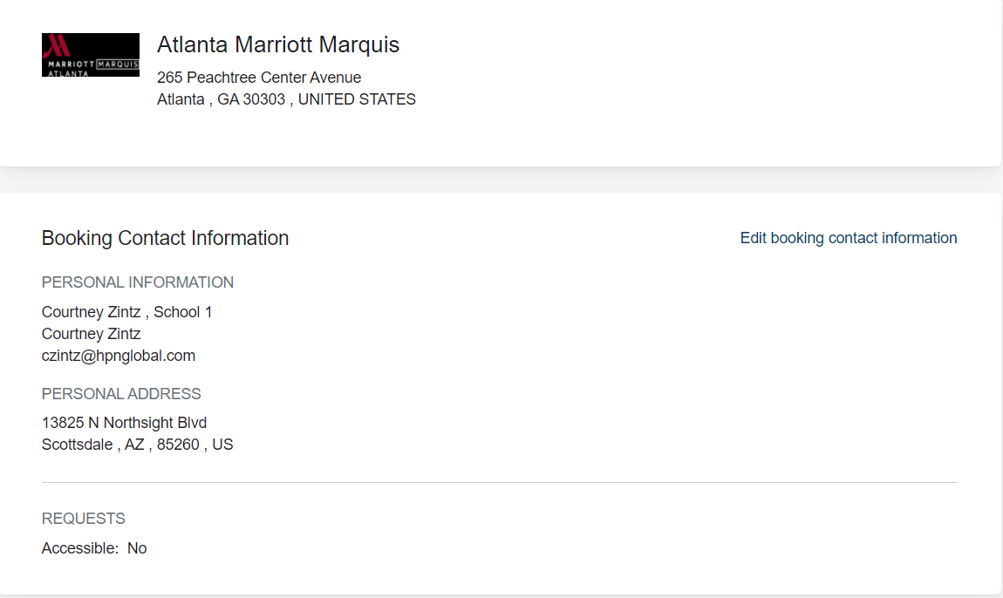
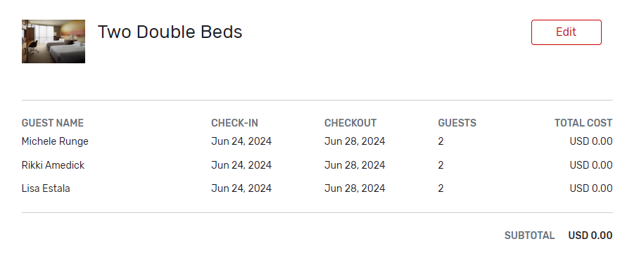
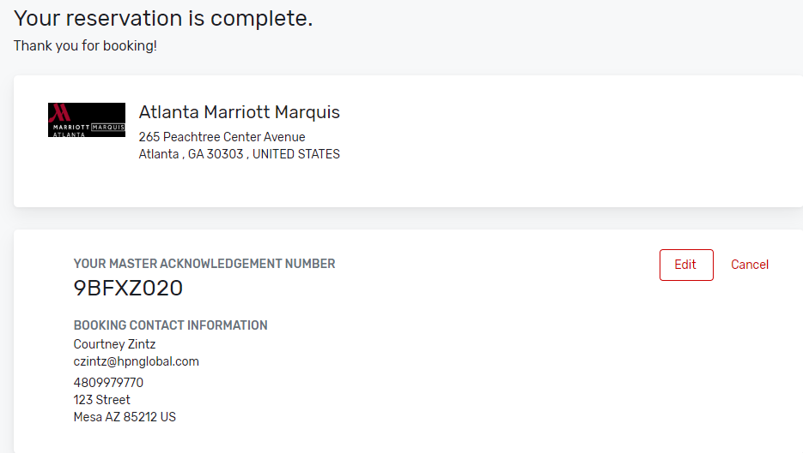
Reservation Process for Advisors
Review all the reservation details and make any last-minute changes to them
Accept the terms and conditions by checking the box next to them
A master acknowledgement will arrive in your email moments after you complete your reservations.

Slide 6
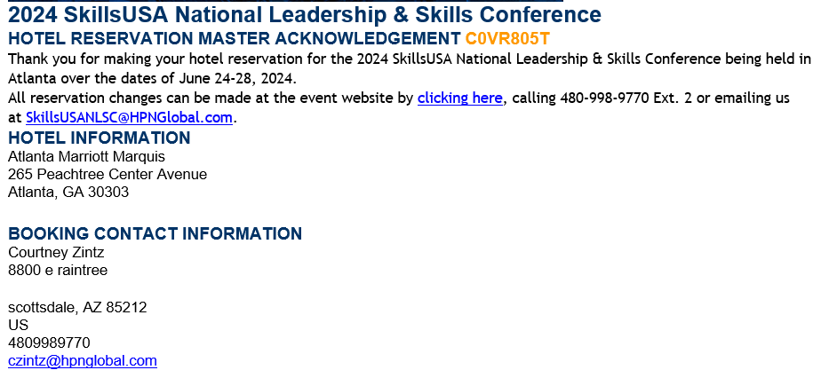
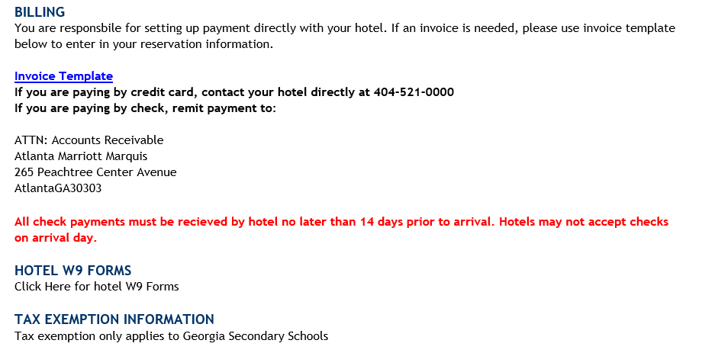
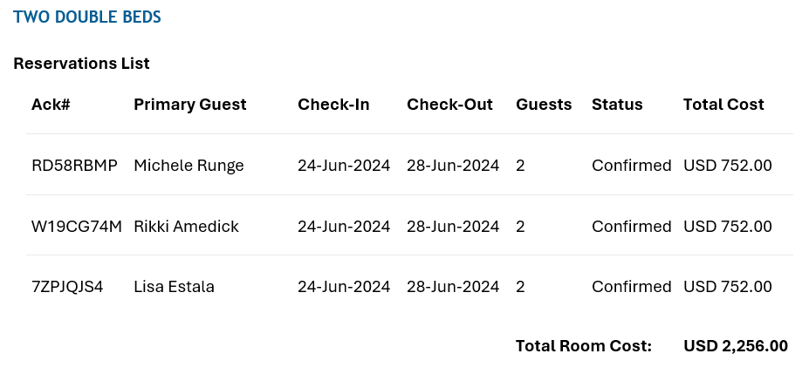
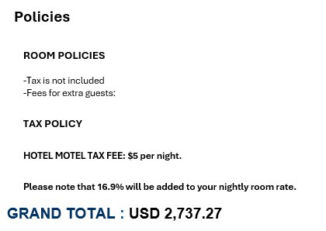
Master Acknowledgement Sample

Slide 7
Helpful Hints
When a reservation is created, through the Group Booking Workflow on the website, rooms cannot be added to it. If you need additional reservations, you can make a new reservation via Passkey. The new reservation (s) would have a separate master acknowledgement number.
If you are making more than one reservation, please utilize the Passkey via your desktop verses mobile app.
Have all attendee names and roommate assignments together prior to starting the housing process. All student names are required to be put into Passkey.
A master acknowledgement will arrive in your email moments after you complete your reservations.

Slide 8
Who to Contact?
Going forward, please reach out to the SkillsUSA NLSC Housing team with any questions related to your hotel room block. We are here for anything you may need to ensure a smooth and successful NLSC 2024!
Courtney Zintz
Director of Housing
(480) 998-9770 Ext: 2
SkillsUSANLSC@HPNGlobal.com

Slide 9
Questions?

